Slide 1

FAKE NEWS PREDICTION

Slide 2
SUBMITTED BY : 1 JAGANNATH MESTRY (vu4f2021009)
2 KSHITIJ GHUGE (vu4f2021003)
3 PRANIT TEMKAR (vu4F2021031)
4 ABHISHEK PALAV (vu4f2021034)
GUIDED BY : MS. MEDHA KULKARNI

Slide 3
INDEX
ABSTRACT
INTRODUCTION
EXISTING SYSTEM
COLLECTING DATA
PROBLEM STATEMENT
OBJECTIVE
NEED OF PROJECT
SOFTWARE REQUIREMENTS
HARDWARE REQUIREMENTS
BASIC WORKING OF SYSTEM
FUTURE SCOPE
REFERENCES
THE END

Slide 4
ABSTRACT
As time flows, the amount of data especially text data increases exponentially.
Though political, economic, organizational, or even personal. This discusses the approach of natural language processing and machine learning.
The fake news on social media and various other media is wide spreading and is a matter of serious concern due to its ability to cause a lot of social and national damage with destructive impacts. A lot of research is already focused on detecting it.
Verifying the authenticity of news needs to have prime importance though a difficult task. This paper outlines a new approach for finding the genuineness of news content.
This helps to eliminate the rumors from spreading through social platforms.
By using the web scraping method, we assemble the news content related to the news posted for checking.

Slide 5
INTRODUCTION
Fake News Prediction is a natural language processing task that involves identifying and classifying news articles or other types of text as real or fake.
The goal of fake news detection is to develop algorithms that can automatically identify and flag fake news articles, which can be used to combat misinformation and promote the dissemination of accurate information.
Fake news, information bubbles, news manipulation and the lack of trust in the media are growing problems within our society.
However, in order to start addressing this problem, an indepth understanding of fake news and its origins is required.
Only then one can look into the different techniques and fields of machine learning (ML), natural language processing (NLP) and artificial intelligence (AI) that could help us fight this situation.
“Fake news” has been used in a multitude of ways in the last half a year and multiple definitions have been given.
Despite all these shortcomings, several entities have tried to categorize fake news in different manners.

Slide 6
INTRODUCTION
These days’ fake news is creating different issues from sarcastic articles to a fabricated news and plan government propaganda in some outlets.
Fake news and lack of trust in the media are growing problems with huge ramifications in our society.
Obviously, a purposely misleading story is “fake news “ but lately blathering social media’s discourse is changing its definition.
Some of them now use the term to dismiss the facts counter to their preferred viewpoints.
Facebook has been at the epicenter of much critique following media attention.
They have already implemented a feature to flag fake news on the site when a user sees’s it ; they have also said publicly they are working on to to distinguish these articles in an automated way.

Slide 7
COLLECTING DATA
So, there must be two parts to the data-acquisition process, “fake news” and “real news”.
Collecting the fake news was easy as Kaggle released a fake news dataset consisting of 13,000 articles published during the 2016 election cycle. Now the later part is very difficult.
That is to get the real news for the fake news dataset.
It requires huge work around many Sites because it was the only way to do web scraping thousands of articles from numerous websites.
With the help of web scraping a total of 5279 articles, real news dataset was generated, mostly from media organizations (New York Times, WSJ, Bloomberg, NPR, Guardian , Times of India , Bombay Times ) which were published around 2015 – 2016.

Slide 8
EXISTING SYSTEM
After analyzing the necessities of the task to be performed, the next step is to analyze the problem and understand its context.
Understanding the properties and necessities of a new system is more difficult and requires creative thinking and understanding of existing running system.
Existing system is manually, so it increases the chances of errors
Consumes large volume of pare work.
Immediate response to the query’s is difficult.
More stationary use so they are expensive

Slide 9
PROBLEM STATEMENT
A major challenge in fake news detection is to detect it in the early phase.
Another challenge in fake news detection is the unavailability or the shortage of labelled data for training the detection models.
We propose a novel fake news detection framework that can address these challenges.
It helps us to detect fake news really easily.
Often sensational news is created and spread through social media to achieve intended end.
On the other hand, it may also involve narration of a true fact however being deliberately exaggerated.
This may also affect the affect the importance of serious news media. The problem is to identify the authenticity of the news and online content.
Equally important problem is to identify the bots involved in spreading false news .

Slide 10
OBJECTIVE
The aim of this work is to create a system or model that can use the data of past news reports and predict the chances of a news report being fake or not.
Various researchers have attempted solving this challenge in a multitude of ways to test which method works and get desirable results.
Fake news is information that is false or misleading and is presented as real news.
The term ‘fake news’ became mainstream during the 2016 presidential elections in United States.
Following this, Google, Twitter, Facebook took steps to combat fake news.
However, due to the exponential growth of information in online news portals and social media sites, distinguishing between real and fake news has become difficult.

Slide 11
NEED OF PROJECT
Effective fake news detection will reduce defamation of individuals: A common practice to hide the source of the entity spreading fake news is to hijack other individuals' accounts.
The owners of such accounts may be defamed, e.g. by the spread of fake news.
The fake news design started basically to dupe per-clients, increase readership, and is oftentimes used as a strategy for mental battling.
Advances in the development and the spread of news through different sorts of media, without truly checking the real factors, have extended the spread of fake news today.

Slide 12
SOFTWARE REQUIREMENTS
Operating system- Windows 11 and Macos
IDE – Visual Code Studio
Front End – JavaScript , HTML, CSS

Slide 13
HARDWARE REQUIEMENTS
Intel core i3 11th generation
RAM used: 4GB.
Processor: 1.4 Ghz 64 bit
Display : (800 ×600) Capable Video adapter
Disk Space : 500 MB

Slide 14
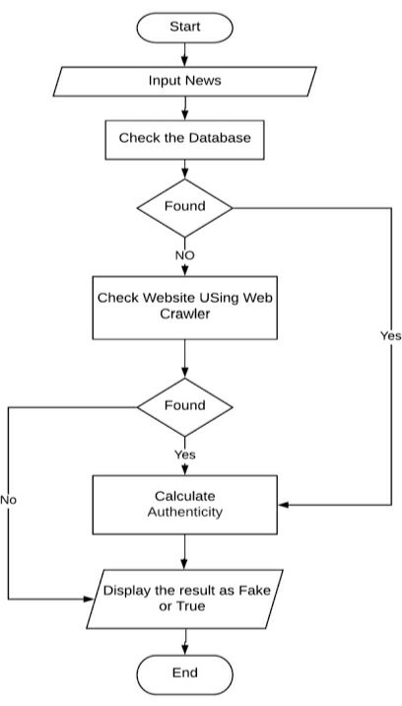
BASIC WORKING

Slide 15
WORKING
The problem can be broken down into 3 statements :- Use NLP to check the authenticity of a news article.
If the user has a query about the authenticity of a search query then we he/she can directly search on our platform and using our custom algorithm we output a confidence score.
Check the authenticity of a news source. These sections have been produced as search fields to take inputs in 3 different forms in our implementation of the problem statement.
1 ST Search Field: The dataset available to us is split into the test and training sets using the train _test _split () function of Sci kit-learn.
To get an idea if the words and tokens in the articles have a significant impact on whether the news in it is actually fake or real, we use Count Vectorizer and Tfi df Vectorizer.
For the tf idf_ vectorizer the threshold is set to 0.7 which means that the words which appear more than 70% of the time in the articles are not counted in.
The stopwords parameter is used for avoiding the various stop words used commonly in the English language.

Slide 16
FIRST SEARCH
In simple words Articles can be analyzed by feeding them to a machine learning model (Passive Aggressive Classifier) which predicts the reliability of the content after it's trained through predefined datasets of classified real vs fake news.
It seemed like the SVM(Support Vector Machine) would outperform any other model, but as we tested the test data set with Bayesian classifiers such as Multinomial NB, Passive Aggressive Classifier simply outperformed them.
The model was tested with Calibrated Classifier CV for both “isotonic” and “sigmoid” methods both of which provided accuracy scores of close to but below 90%, as well as ensemble based classifiers such as the Random Forest Classifier which couldn’t provide a higher accuracy on the test data set even when the number of decision trees used for it was significantly increased.
Simply increasing the number of trees increased the accuracy very slightly whereas the execution time increased significantly.
Therefore we decided that Passive Aggressive Classifier was our best option as it was providing accuracy scores as high as 93% on the test data set.
Apart from its relative simplicity it is also much faster when compared to all the above machine learning models mentioned.

Slide 17
SECOND AND THIRD SEARCH
The second search field asks for keywords to be searched on the net to find sources for those particular keywords in articles.
For this the python package requests is used to pull and provide the HTML and then another python package Beautiful Soup to parse the HTML to extract the headers and the body of the links.
Search terms can be analyzed by doing a Google search (first 100 entries) and and ensuring if the news corresponding to the keywords have been covered by reliable news sources and aggregators.
For every search term covered by a reliable news source it receives a score of +1, while we heavily penalize fake sources.
If multiple fake sources cover the news then we penalize the truth score even harder. We also look for keywords like 'hoax', 'fake', etc in the payload content
The third search field asks for a domain name from the user and tells him/her if the domain is reliable or not.
The domain name is taken as input and the implementation searches for it in manually created databases of blacklisted sites which have a high probability of providing fake news and another database containing the domains which provide reliable news and information.

Slide 18
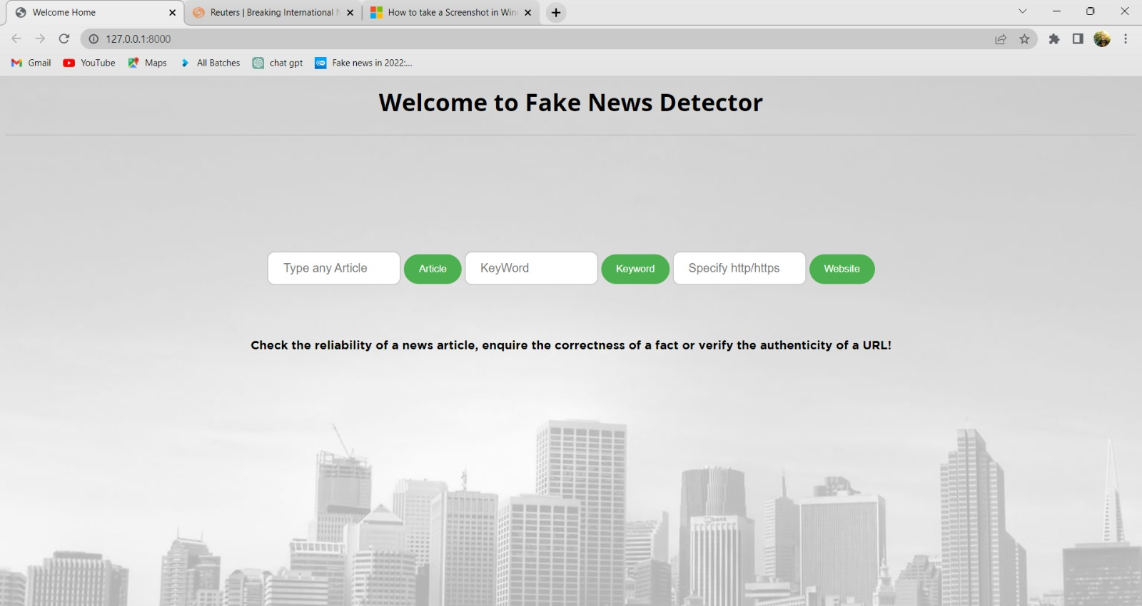

Slide 19


Slide 20
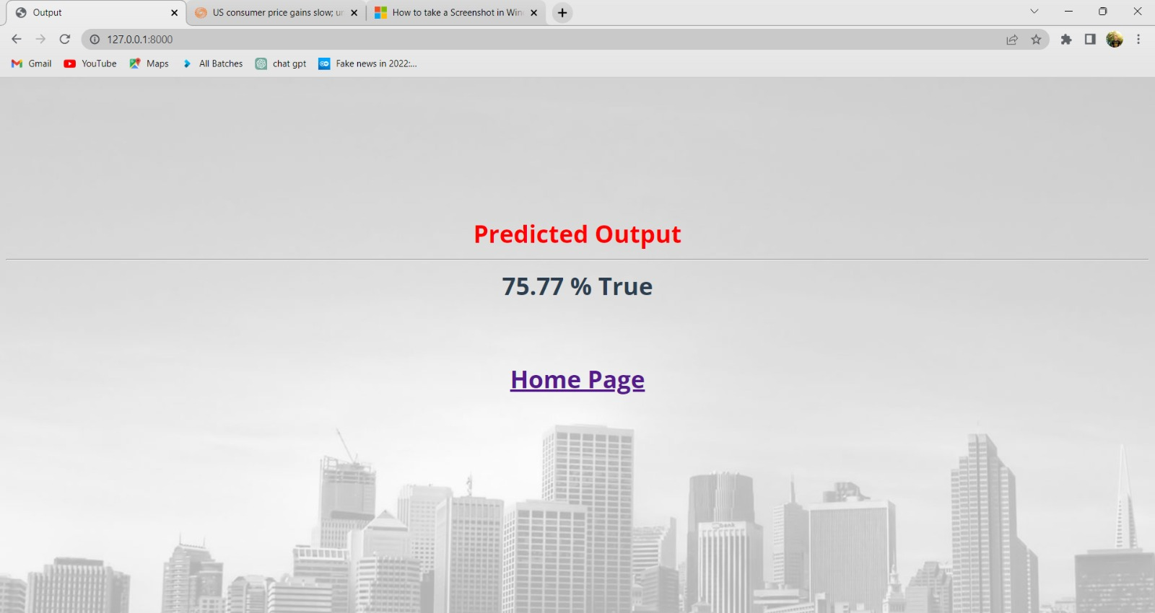

Slide 21
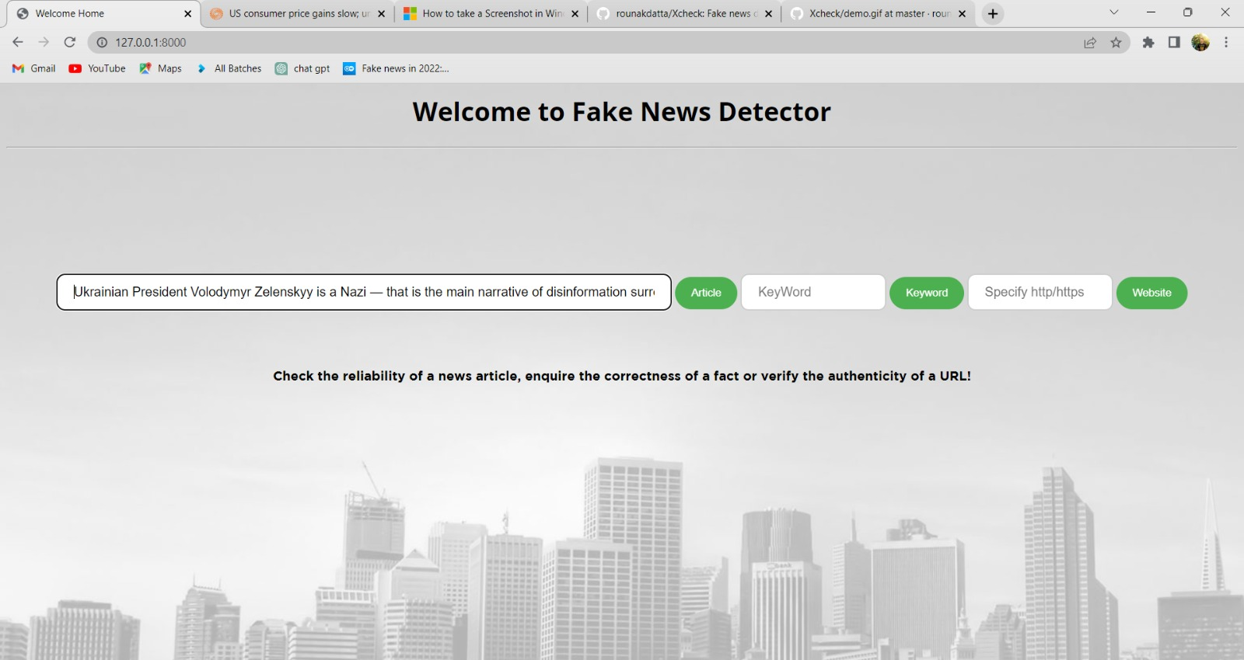

Slide 22
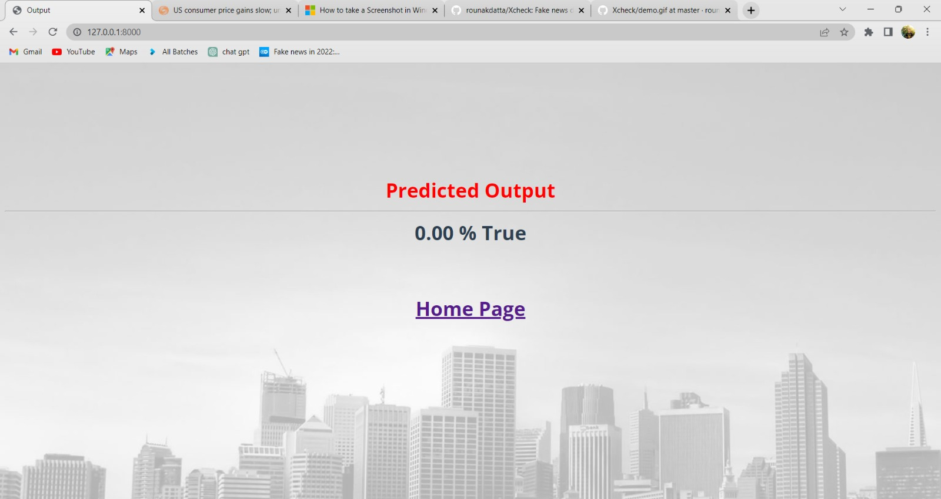

Slide 23
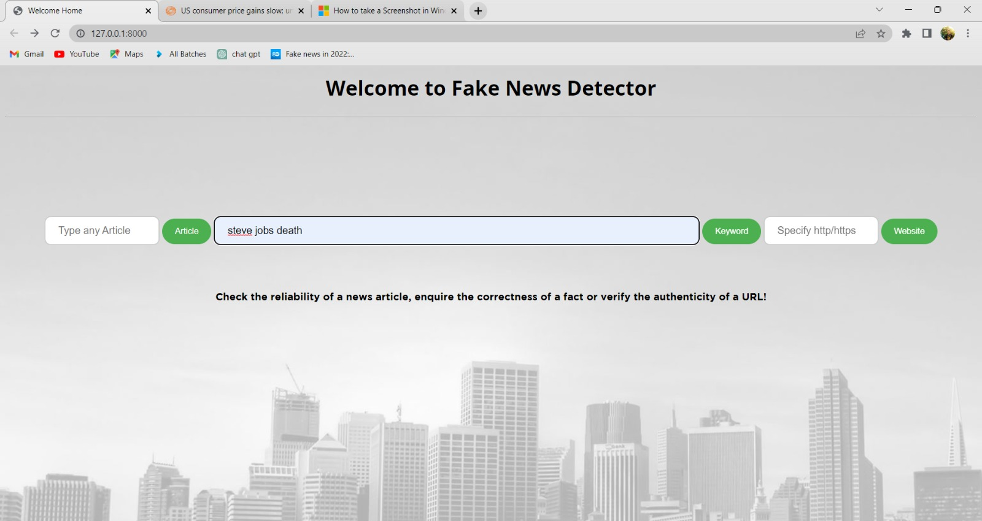

Slide 24


Slide 25
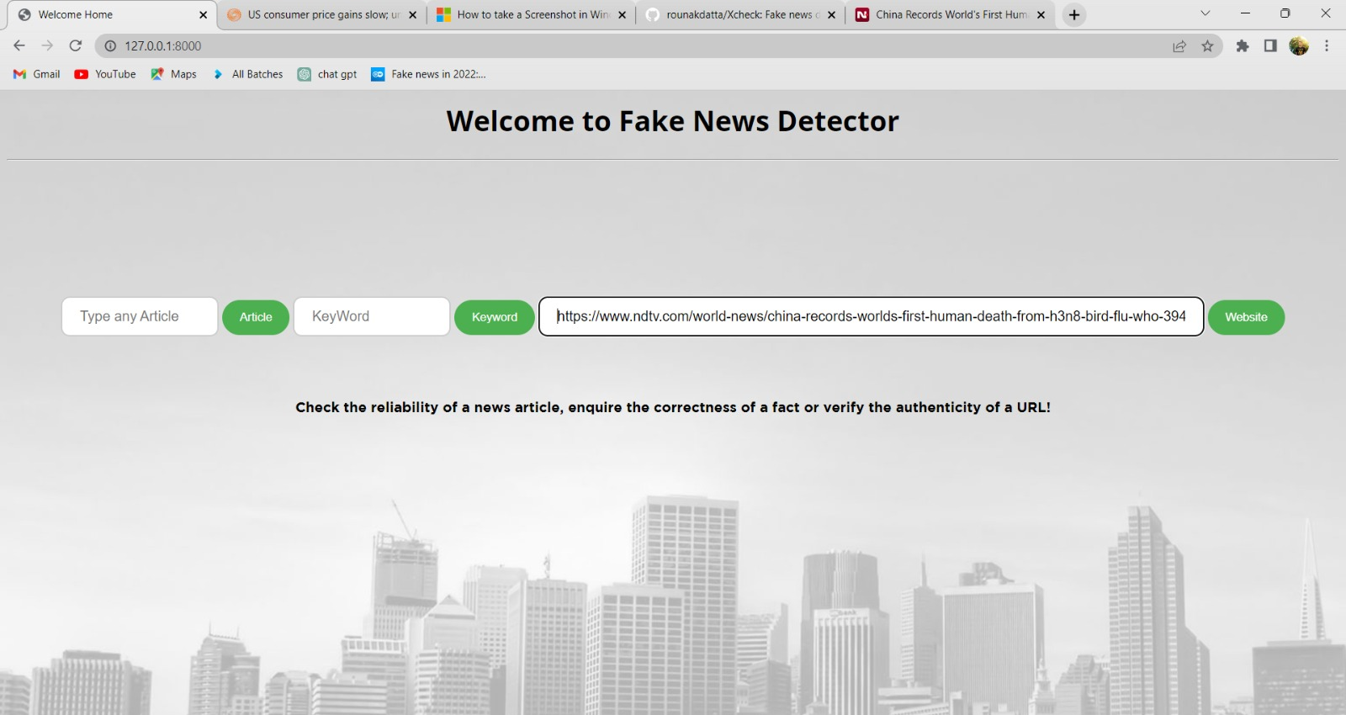

Slide 26
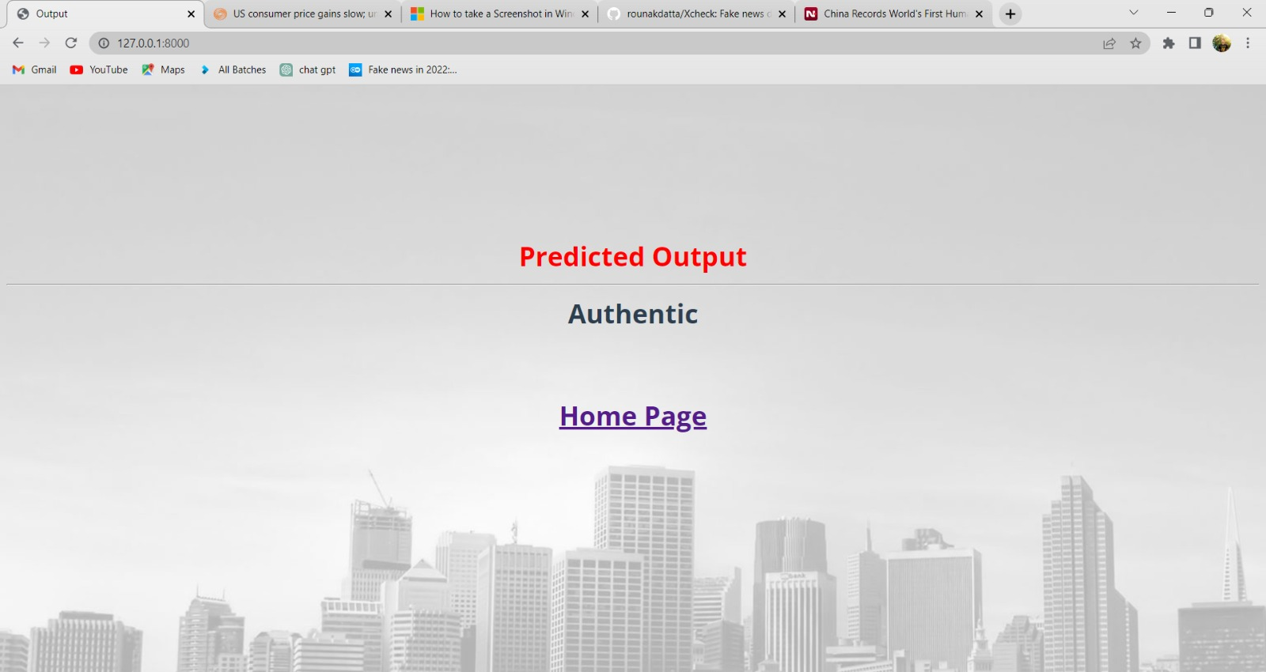

Slide 27
FUTURE SCOPE
Massive amounts of data gave birth to AI systems that are already producing human-like synthetic texts, powering a new scale of disinformation operation .
Based on Natural Language Processing (NLP) techniques, several lifelike text-generating systems have proliferated and they are becoming smarter every day.
This year, OpenAI announced the launch of GPT-3, a tool to produce text that is so real, that in some cases it’s nearly impossible to distinguish from human writing. GPT-3 can also figure out how concepts relate to each other, and discern context.
Tools like this one can be used to generate misinformation, spam, phishing, abuse of legal and governmental processes, and even fake academic essays.

Slide 28
CONCLUSION
Hence we conclude that, The task of classifying news manually requires in-depth knowledge of the domain and expertise to identify anomalies in the text.
In this research, we discussed the problem of classifying fake news articles using machine learning models and ensemble techniques.
The data we used in our work is collected from the World Wide Web and contains news articles from various domains to cover most of the news rather than specifically classifying political news.

Slide 29
REFERENCE
https://www.pantechsolutions.net/fake-news-detection-using-machine-learning
https://link.springer.com/article/10.1007/s41060-021-00302-z
https://www.sciencedirect.com/science/article/pii/S1877050918318210

Slide 30
THANK YOU

